Slide 1
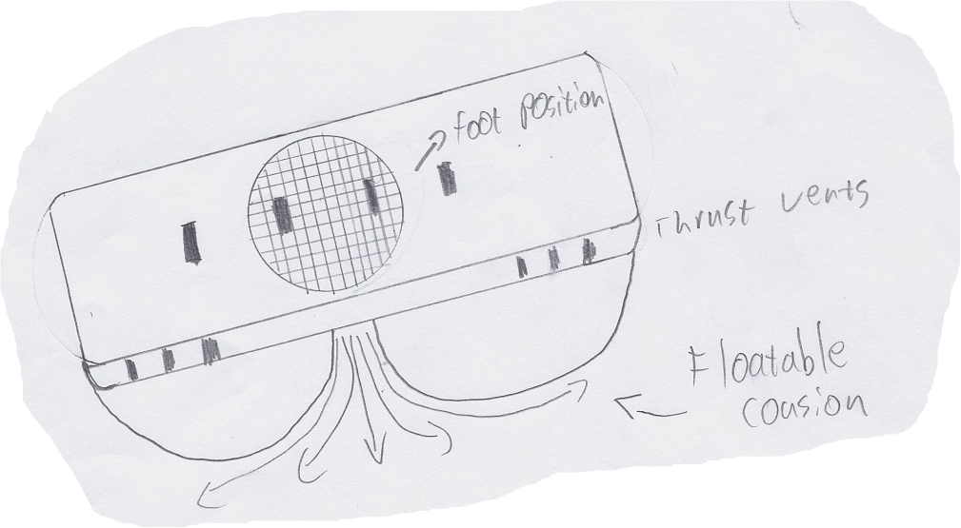
ELEN 1002 – Concepts of Design BSc Applied Computing Project 1: Hoverboard Design 2013 Presented by: Jason Max Chalom
Reference: Uses clipart from Office.com
The University of the Witwatersrand

Slide 2
The Task
I was tasked with making a theoretically functional hoverboard.
It was a difficult Challenge!
It has to be able to:
Hover
Travel horizontally at 30km/h
Carry a 80kg person

Slide 3
What Is a HoverBoard?
It is a conceptual idea which was first seen in the movie ‘Back to the Future’.
It Was shown to be:
Similar to a skateboard or surfboard
Simplistic
Easy to use
Well designed
Sturdy
Lightweight

Slide 4
Why Can This Actually Work?
The Hover Principle:
It is used by many vehicles including boats, aircraft and hovercrafts
This is similar to surfing a wave in the ocean
The air pocket is wedged under the craft
Works like a pillow
Makes the craft able to glide

Slide 5
Points of Design
Simplicity
Lightweight
Practical
Desirable

Slide 6
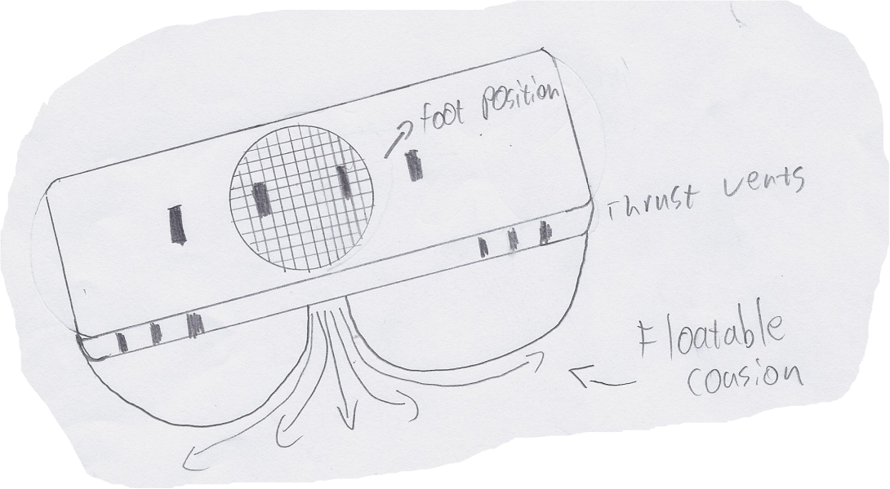
Simplicity
The Hoverboard is:
One piece
Pickup and use
Easy to use
Strap in feet
Put on helmet and padding
Turn on
GO!
Easy to operate
Connected to your cellular phone

Slide 7
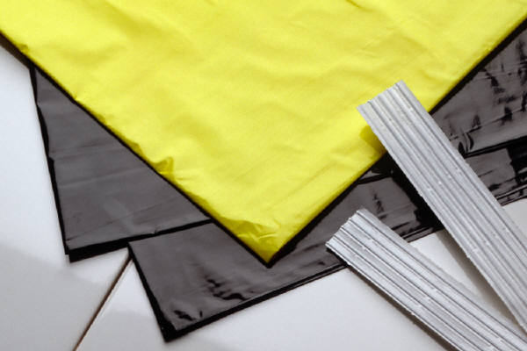
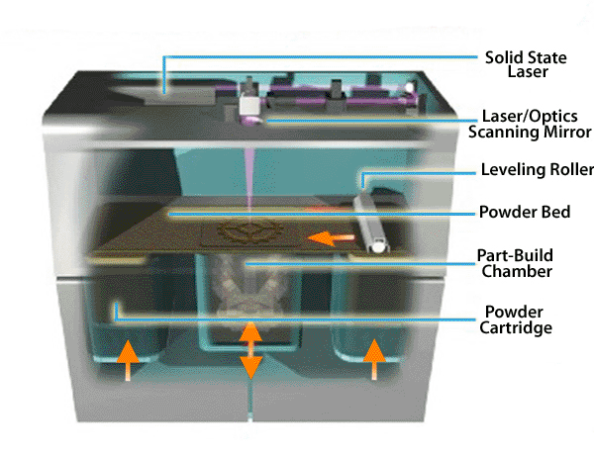
Lightweight
The Design is made primarily of Nylon which is printed on using a selective laser sintering (SLS) machine
Found at: http://www.lasersintering.com/images/services/sls_machine.gif

Slide 8
Practical
Transport Becomes:
Cooler
Easier
Get on and go!
Fast
Up to 30km/h!
Easy to build!
Most parts are printed from digital designs.

Slide 9
Desirable
Already have a market
The idea has become popularised by the film Back to The Future Part II.
Something New
Environmentally friendly.
Made of recyclable materials
Does not produce noxious gases

Slide 10
Design
Uses Existing technology found in Electric Dirt Bikes.
1200 Watt Motor
Batteries
Opensource Arduino Microcontroller
One sensor board which runs with the microcontroller
Builds up pressure under the hoverboard

Slide 11
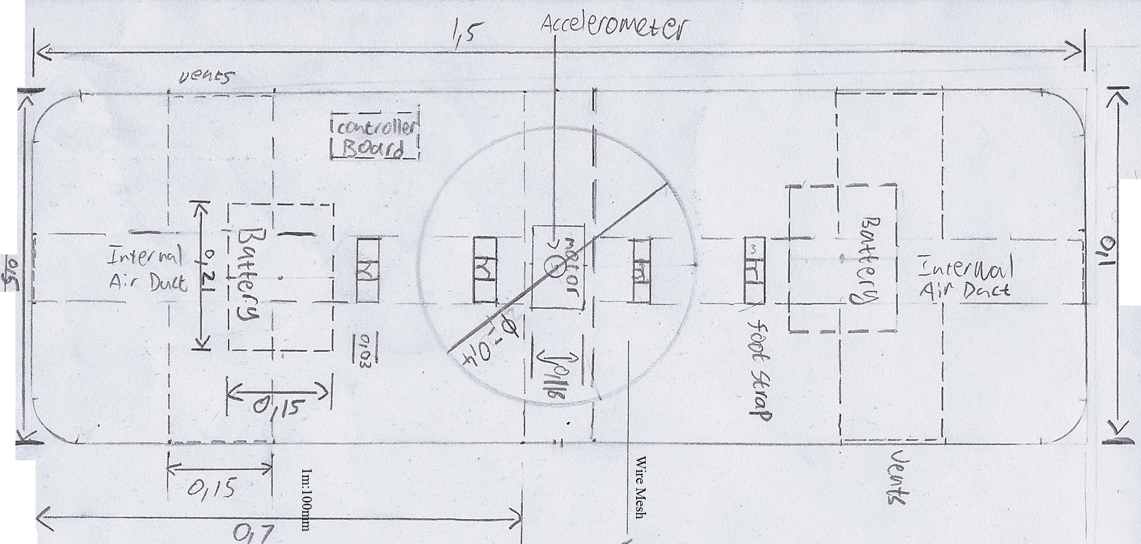
TOP Design
1m:100mm

Slide 12
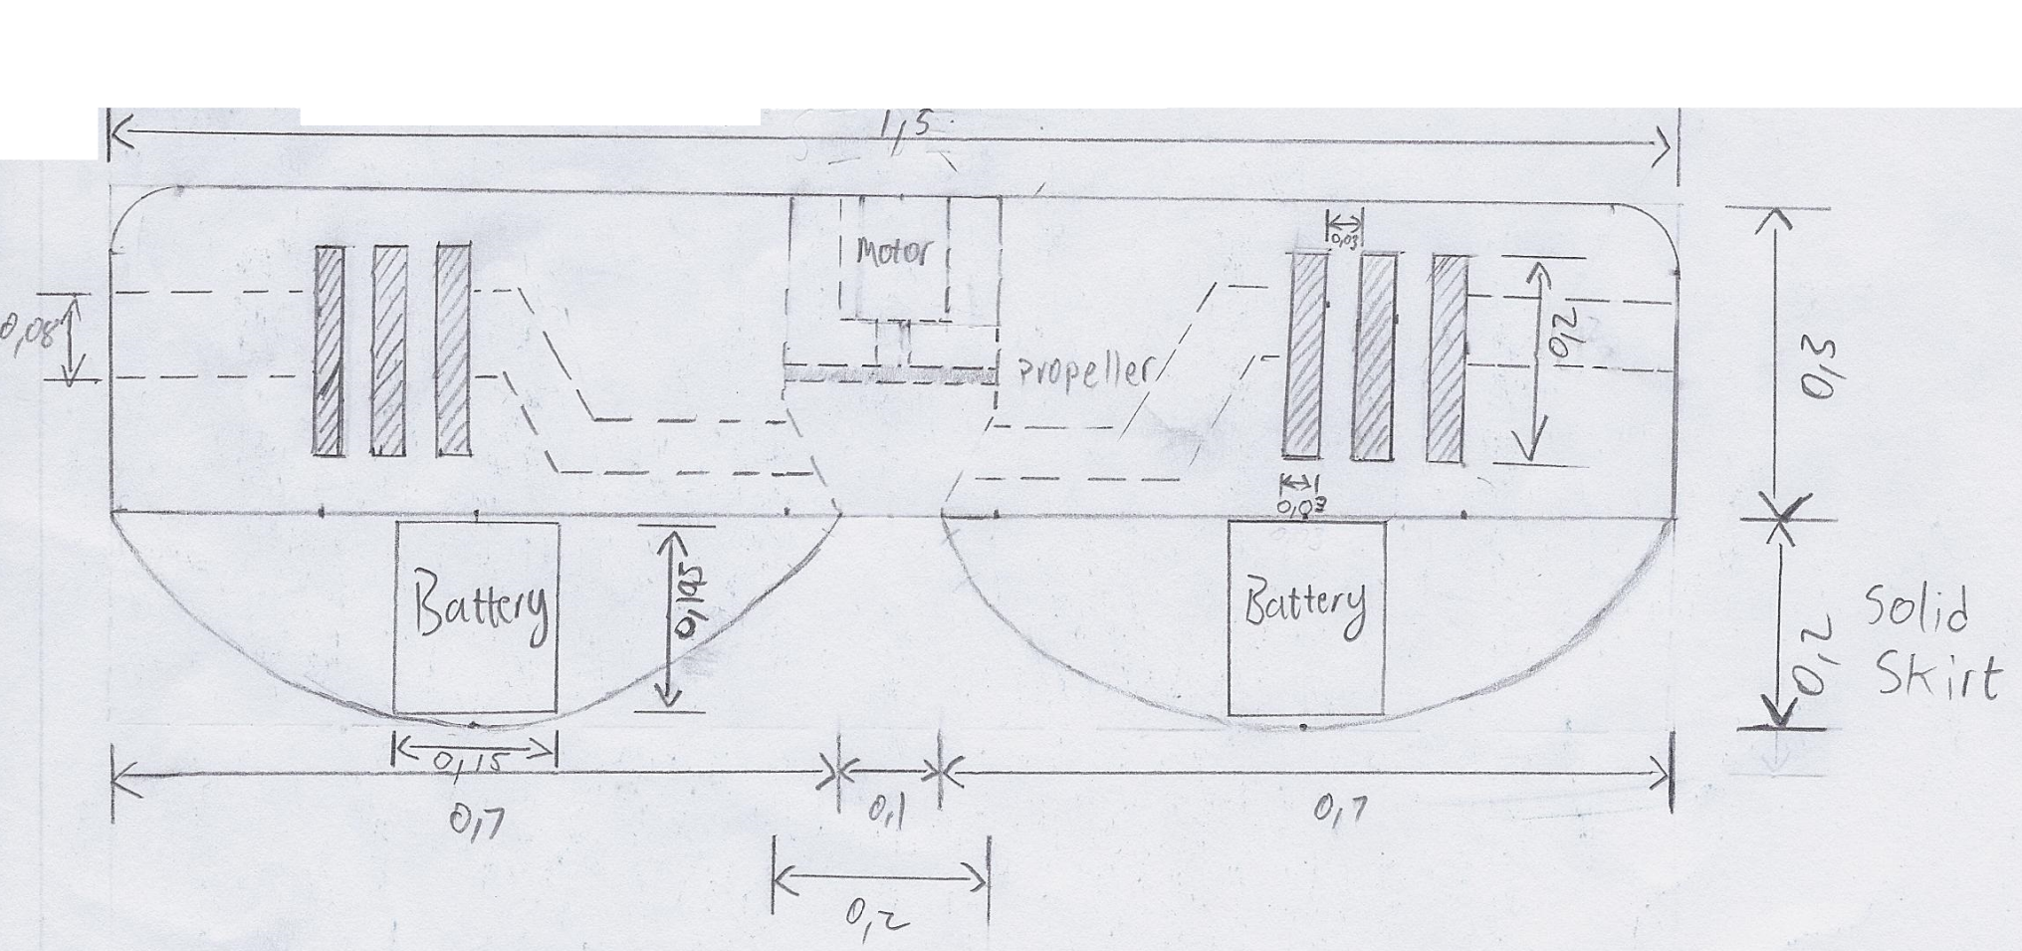
Side Design
1m:100mm

Slide 13
There can be more research and Development
Find better technologies
Power
Super-capacitors
Much more effective
Long lasting
High wattage Motor
Means higher hover
Need Corporate Support to Continue Project!

Slide 14
Questions And Answers

